Slide 1
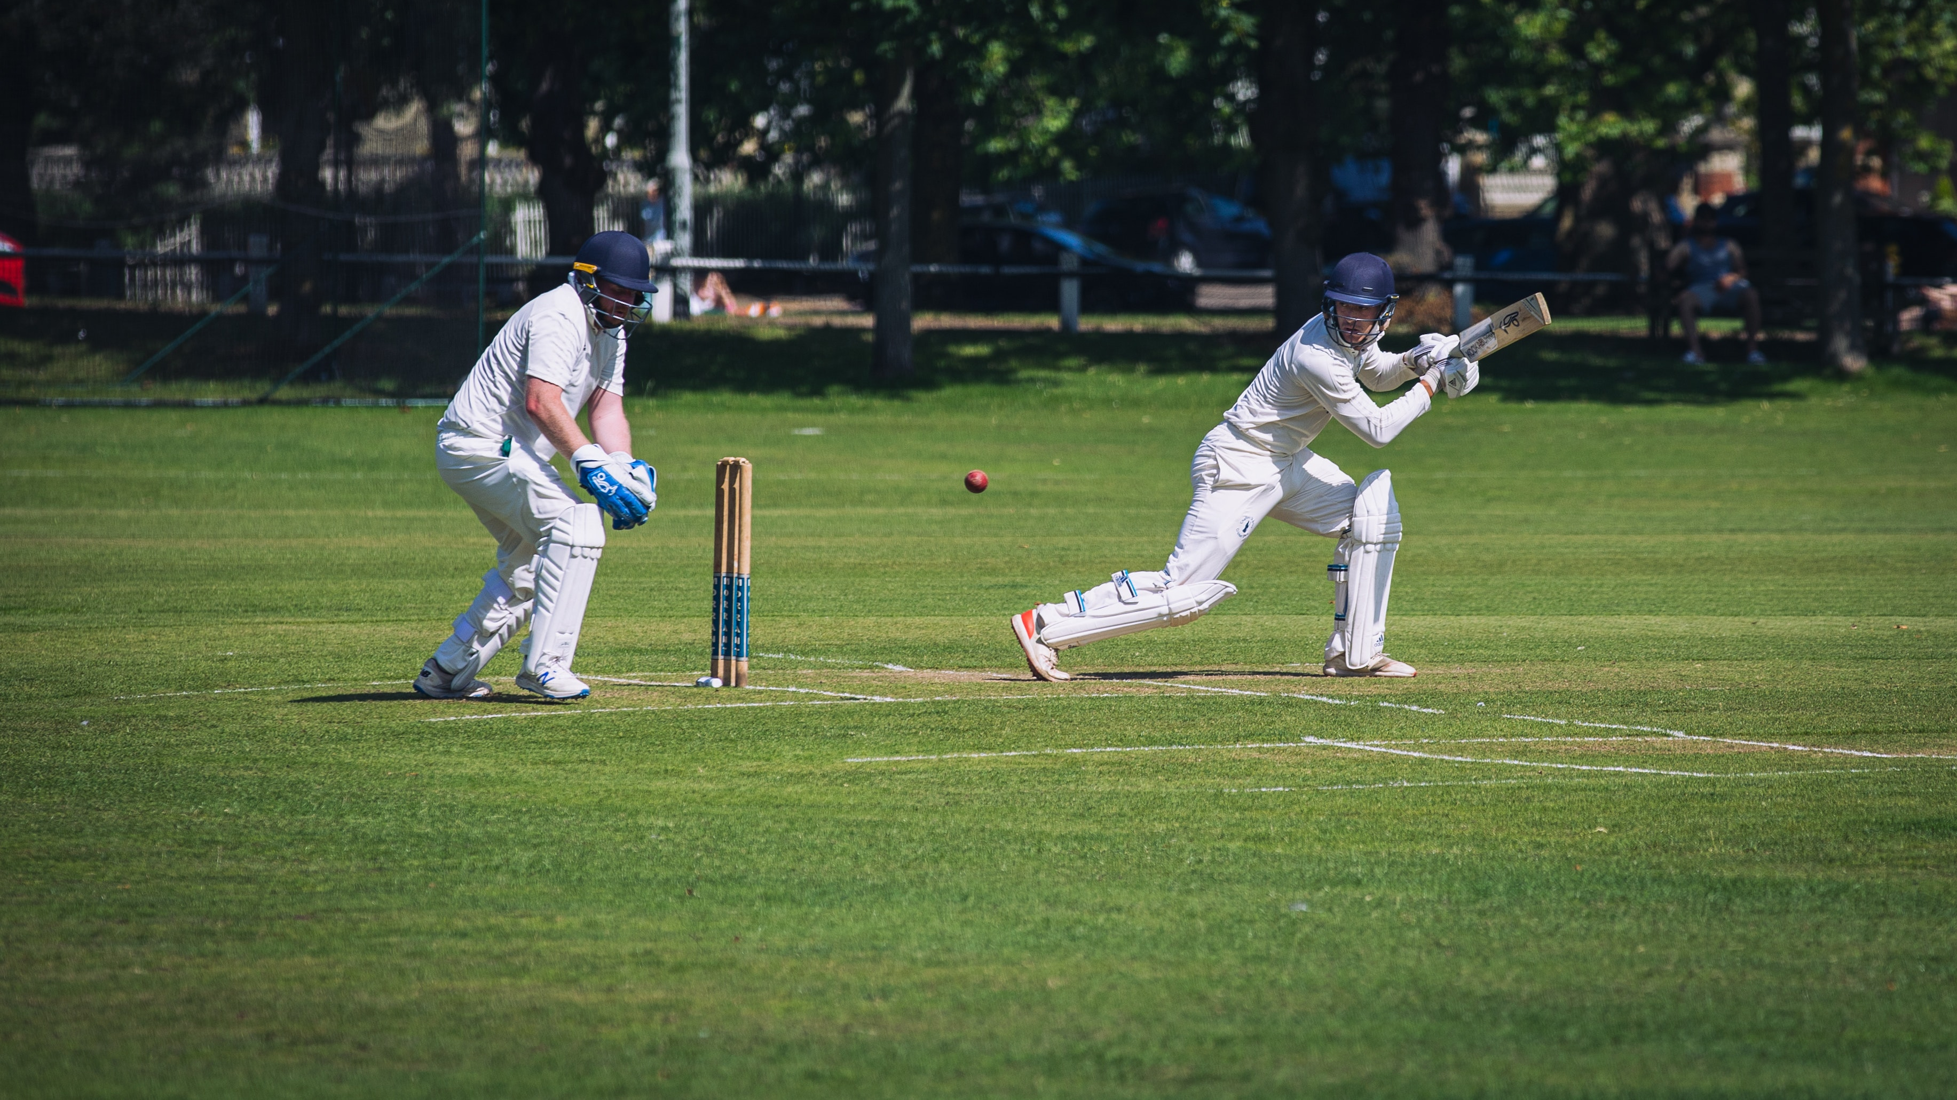
Capstone Project – Cricket Win prediction
Presented – Yogessh Balamurugan

Slide 2

Agenda:
Introduction
Data Preparation
Exploratory Data Analysis
Model Building
Model Tuning
Model selection
Conclusion
Recommendations

Slide 3
Introduction
The project needs to develop strategies for the 5 matches mentioned below to help India win by analyzing the past data of the Indian team matches using machine learning techniques.
1 Test match with England in England. All the match are day matches. In England, it will be rainy season at the time to match.
2 T20 match with Australia in India. All the match are Day and Night matches. In India, it will be winter season at the time to match.
2 ODI match with Sri Lanka in India. All the match are Day and Night matches. In India, it will be winter season at the time to match.
Problem Statement
BCCI has hired an external analytics consulting firm for data analytics. The major objective of this tie up is to extract actionable insights from the historical match data and make strategic changes to make India win. Primary objective is to create Machine Learning models which correctly predicts a win for the Indian Cricket Team. Once a model is developed then you have to extract actionable insights and recommendation. Also, below are the details of the next 10 matches, India is going to play. You have to predict the result of the matches and if you are getting prediction as a Loss then suggest some changes and re-run your model again until you are getting Win as a prediction. You cannot use the same strategy in the entire series, because opponent will get to know your strategy and they can come with counter strategy. Hence for all the below 5 matches you have to suggest unique strategies to make India win. The suggestions should be in-line with the variables that have been mentioned in the given data set.

Slide 4




Workflow
Data Preparation
01
Tools
Exploratory Data Analysis
02
Data Cleaning
03
04
Data Preprocessing
Model Building
05
06
Model Tuning
Model Evaluation
07

Slide 5
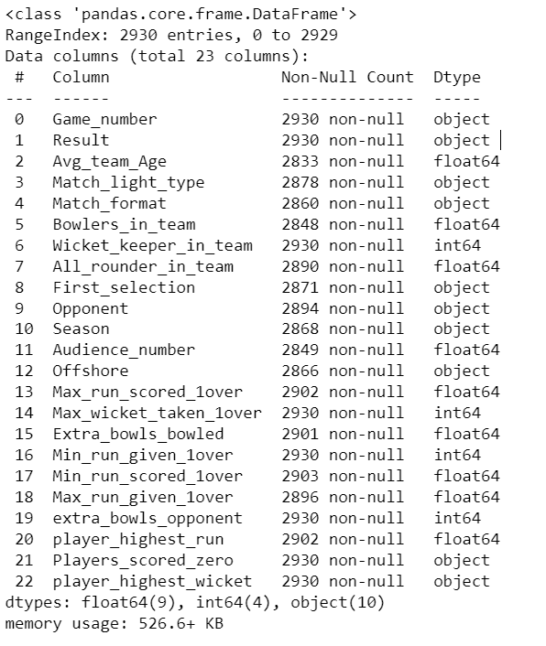
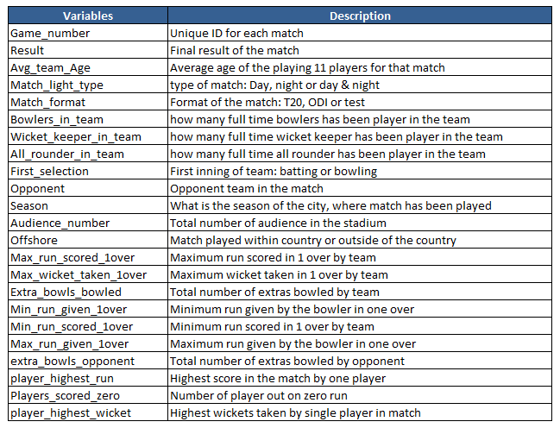
The shape of the dataset has 2930 rows and 23 columns which includes datatypes of 9 columns of float datatype, 4 columns of integer datatype and 10 columns of object datatype. The target variables is ‘Result’.

Slide 6
Exploratory data analysis
There are null values found in the columns of Avg_team_Age, Match_light_type, Match_format, Bowlers_in_team, All_rounder_in_team, First_selection, Opponent, Season, Audience_number, Offshore, Max_run_scored_1over, Extra_bowls_bowled, Min_run_scored_1over, Max_run_given_1over, player_highest_run.
Imputed the null values of match format columns using KNN imputer and for categorical columns such as Offshore, Season, First_selection, Match_light_type imputed null values with mode.
Missing Value treatment
01
Dropped rows where Avg_team_Age is greater than 50, the reason is the Indian players' average team age greater than 50 seems unrealistic and the players will not be fit at this age to play the match, and the age is too old.
Thus, I have dropped the rows. Drop rows with null values in 'Opponent’ columns, since we are unaware of the opponent data, and imputing the values doesn’t get the right data while strategizing against the opponent.
For other variables outliers seems to be a real value.
Outlier Treatment
02
Converted categorical variables to numerical variables using label encoder.
Feature selection was done using SelectKBest with ANOVA F-value and also variance for each variable is calculated. Dropped the variables Wicket_keeper_in_team and Audience_number for further model building.
Label Encoding & Feature selection
03

Slide 7
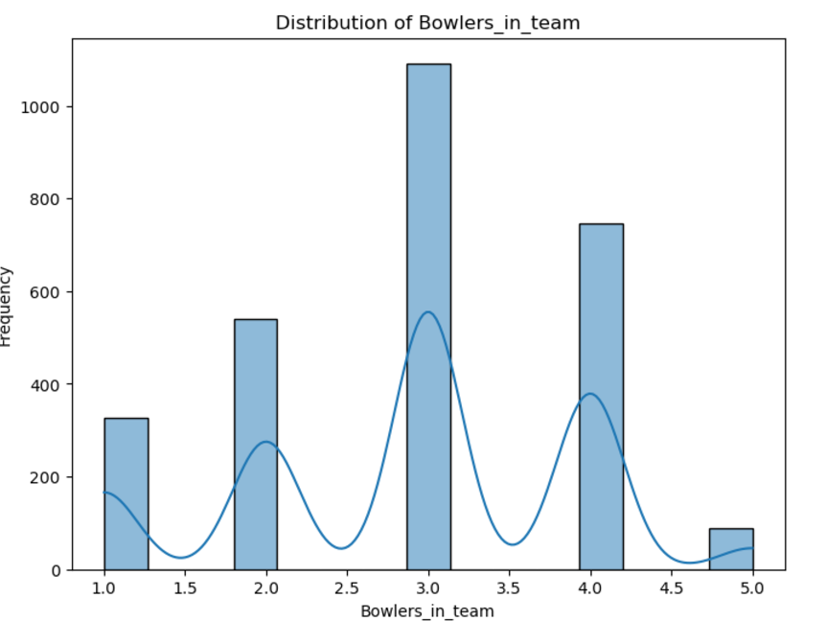
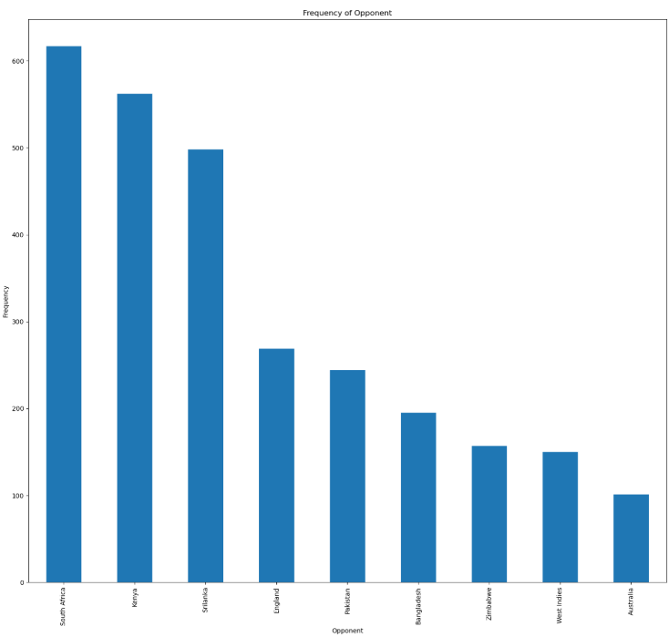
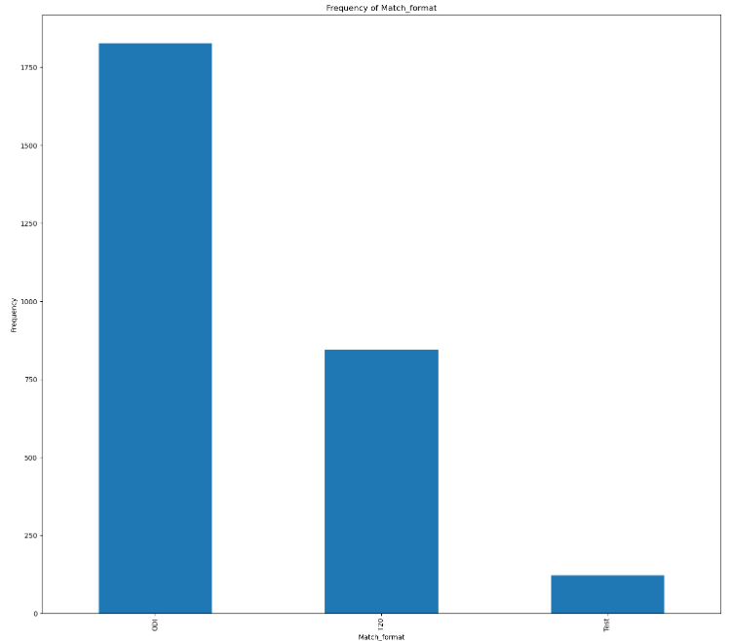
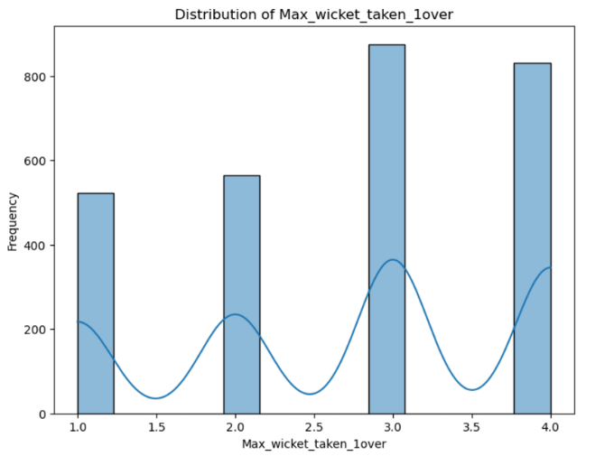
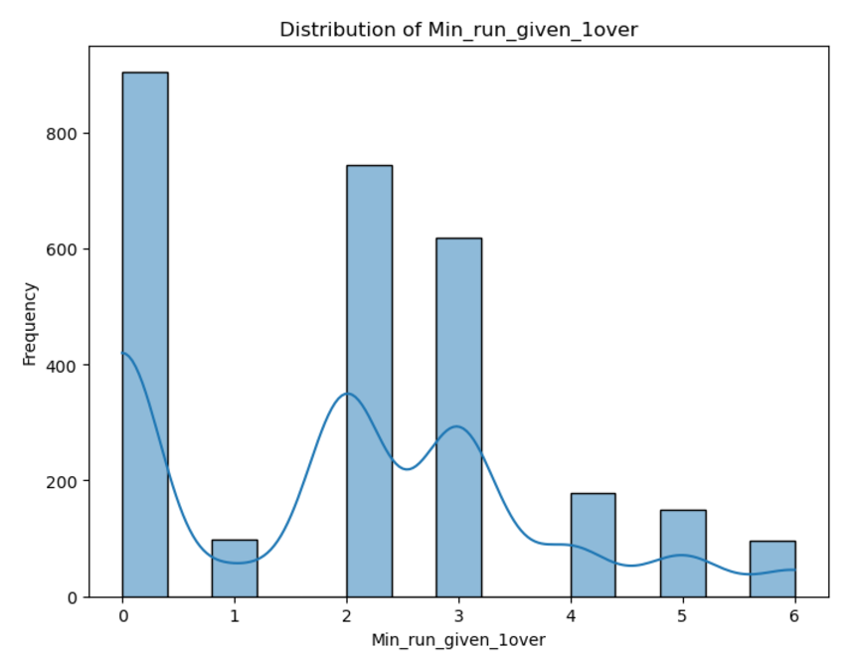
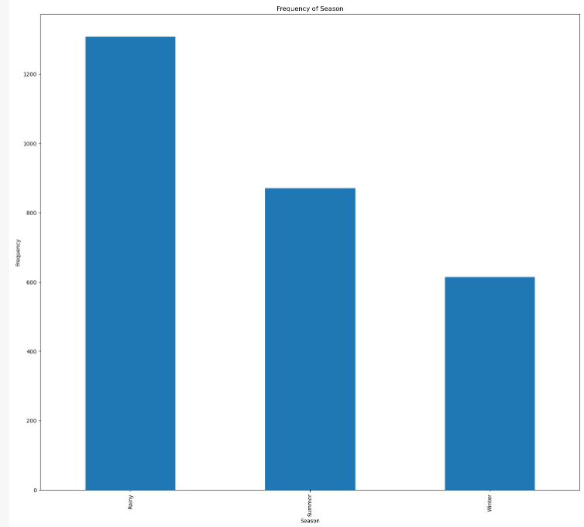
Insights from Univariate Analysis
The maximum number of bowlers found to be 3 across all formats.
The maximum number of scored in 1 over is 25. The maximum wicket taken per over is 4.
The minimum run given per over is 6 runs.
Indian team has played ODI format (65%) the most followed by T20 (30%) and test formats(4%).
Most number of matches are played in rainy seasons (47%).
Indian team has frequently faced with South Africa (22%) as an opponent, followed by Kenya (20%), Srilanka (18%), England(10%), Pakistan (9%), Bangladesh(7%), Zimbabwe (6%), West Indies(5%) and Australia (4%).

Slide 8
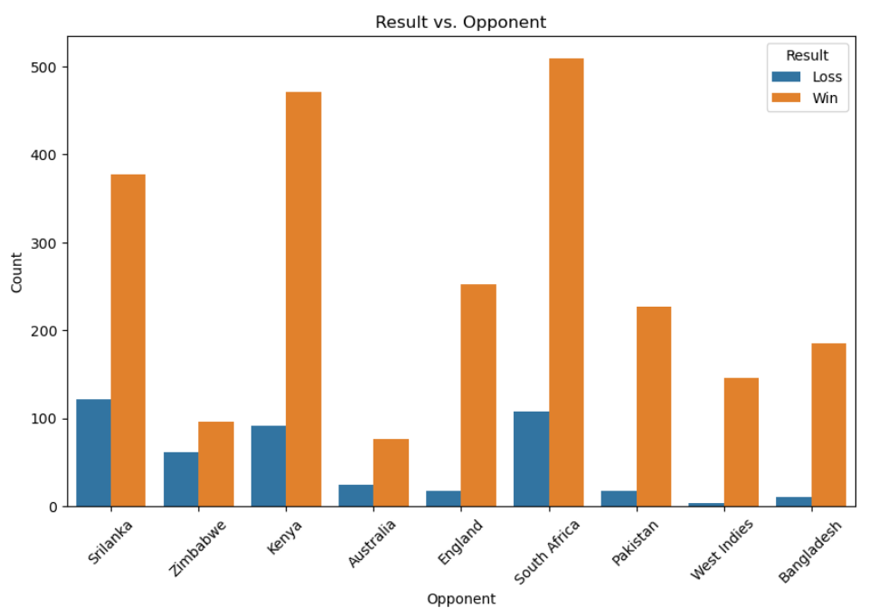
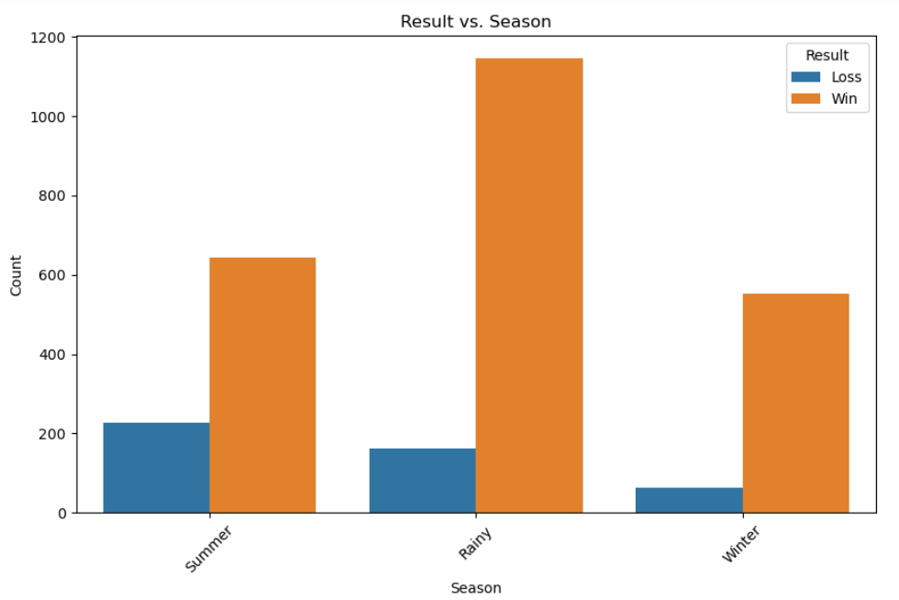
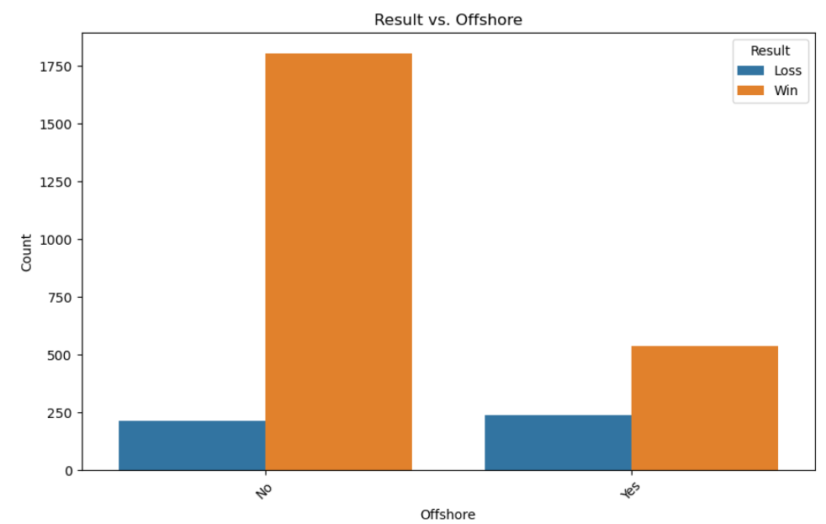
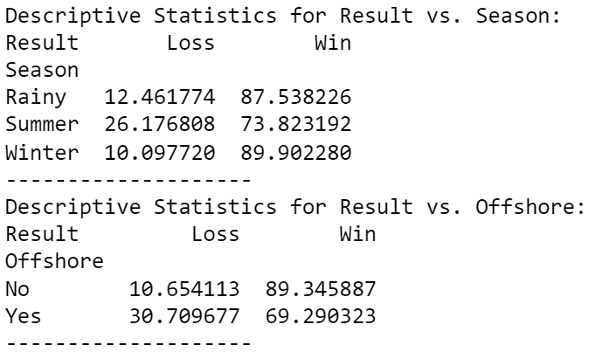
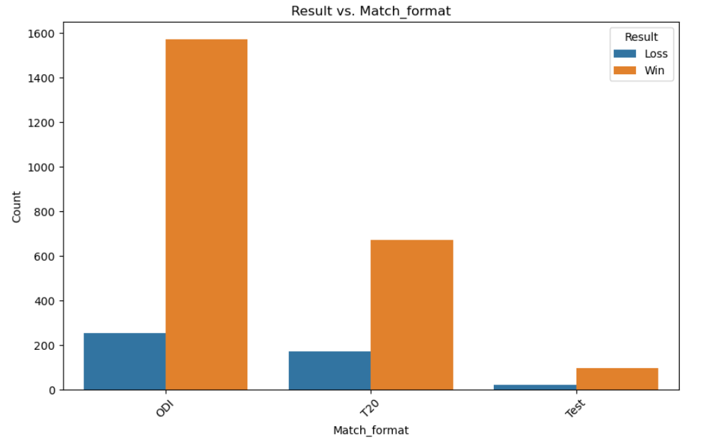
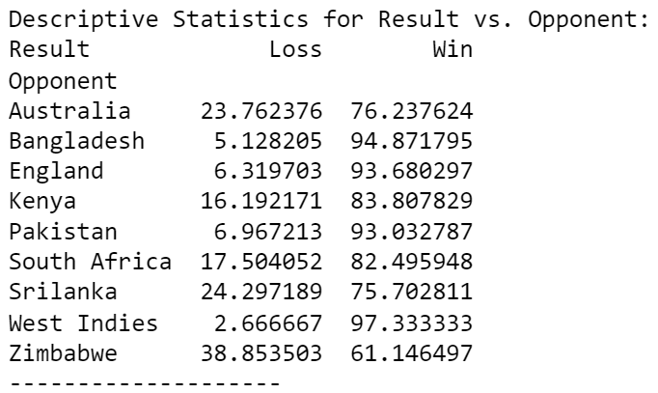
Insights from Bivariate Analysis
Indian team has won 89% of matches by playing in India and 69% of matches by playing in offshore.
When the Indian team decided to bat first they won 85% of matches and lost 15% of matches.
The team has win record with different types of formats as 85% of matches in ODI format, 79.5% of matches in T20 format, 80.3% of matches in Test format.
They have won 73.8% matches by playing in summer season, 87.5% matches by rainy season and 89.9% matches by playing in rainy season.
Indian team has highest success rate by playing against west indies with 97.3% and they have played most matches against south Africa with success rate of 75.7% and they have lost 24.3% matches against the same opponent.

Slide 9
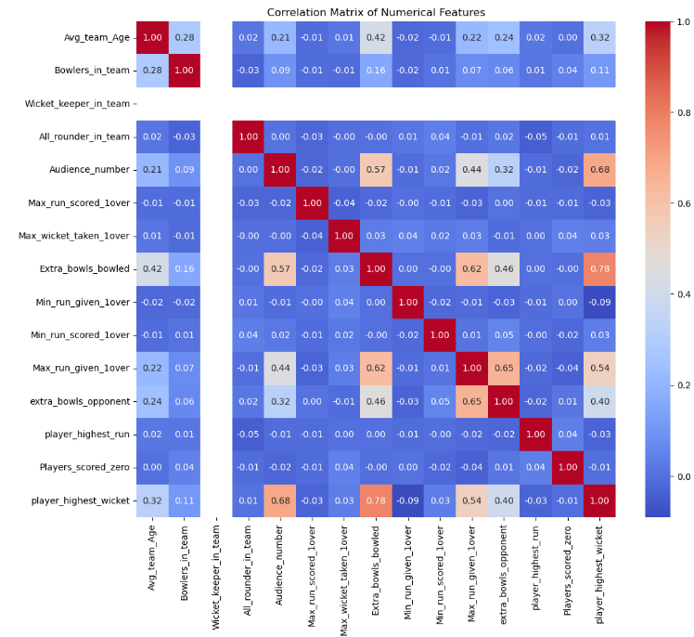
Insights from Multivariate Analysis
We can see multicollinearity among the variables in the heatmap.
There is a high correlation between player highest wicket and Extra bowls bowled.
There are also few negative correlations found between player highest run and all-rounder in team.

Slide 10
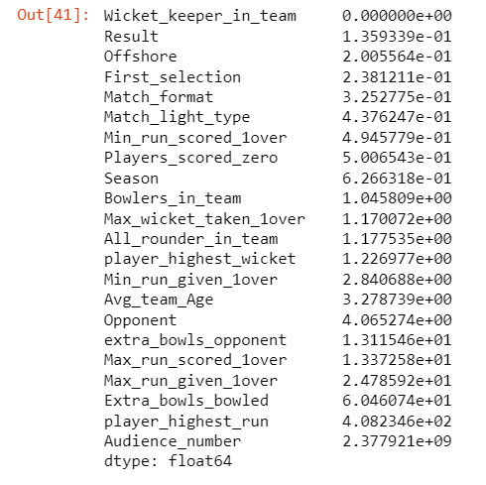
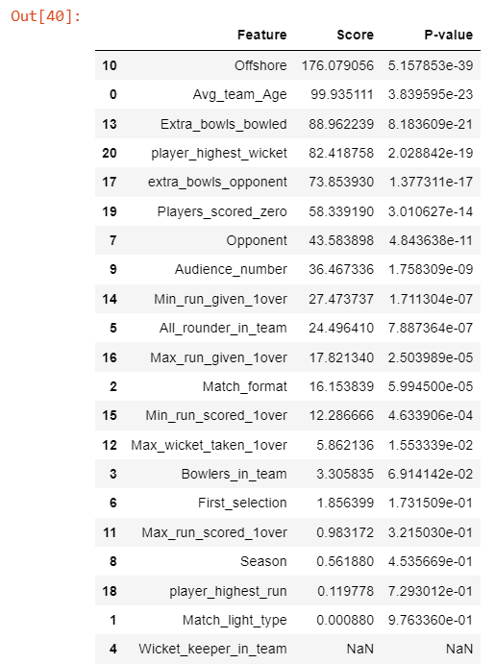
Feature Selection
SelectKBest is a Python feature selection method. It chooses the top k features based on their scores, which are computed using a predetermined scoring system.
To predict the categorical output to predict the result and having numerical input features, I have used SelectKBest with ANOVA F-value for feature selection and also calculated the variance for each numerical feature.
Dropped the ‘Game number’ column, it represents only the game number of matches.
Dropped the column ‘Wicket keeper in team’ from the inference of selectKBest feature. After dropping the 'Audience_number' column the accuracy in the logistic regression has increased. Thus, both the variables has been eliminated for the train and test model.
Eliminated features

Slide 11
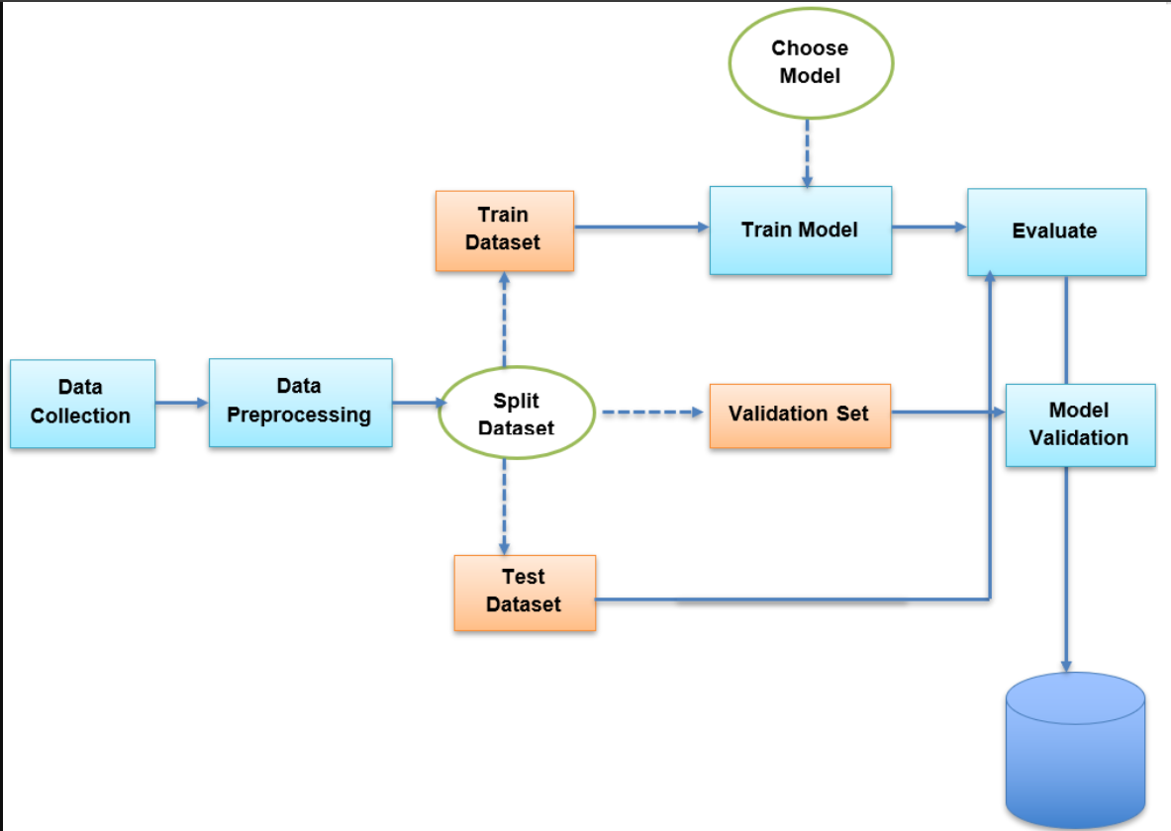
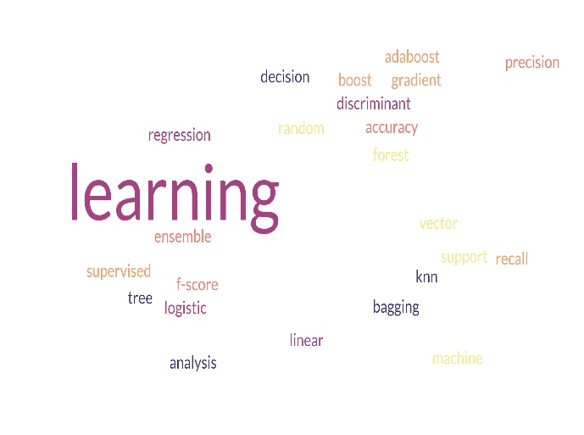
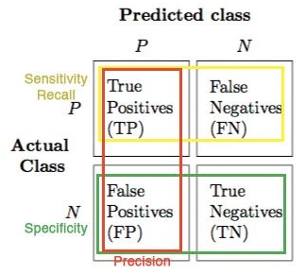
Feature Selection
The target variables is ‘Result’.
The various classification model was used to predict the categorical variables ‘Result’ are:
Logistic Regression
Linear Discriminant Analysis (LDA)
KNN
Decision Tree
Bagging
Random Forest
Support Vector Machine (SVM)
AdaBoost
Gradient Boost

Slide 12
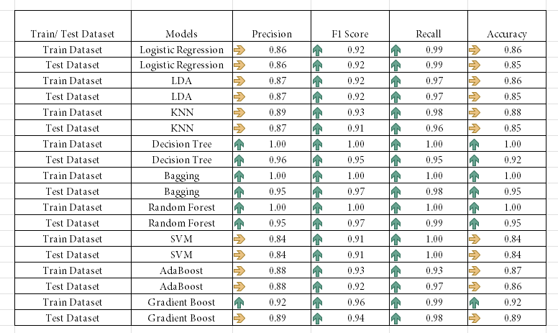
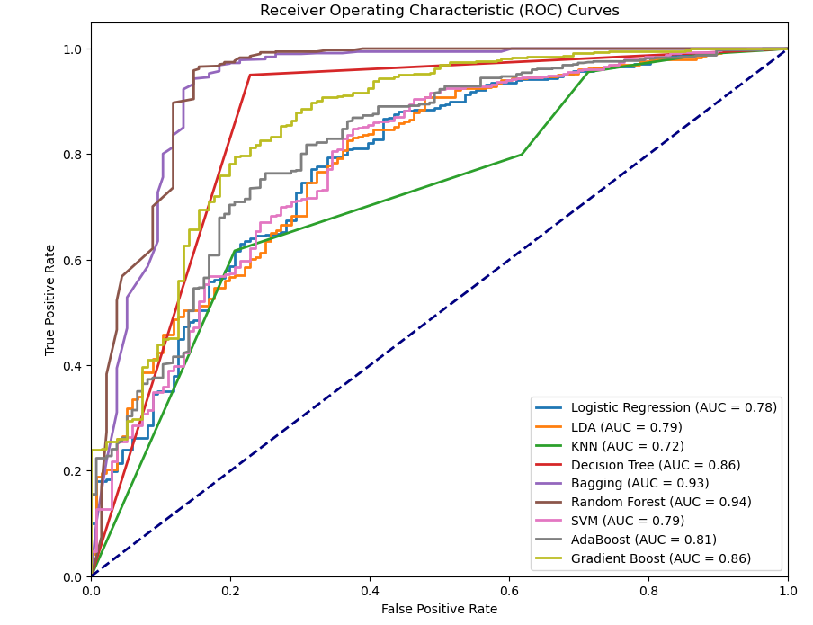
Interpretation of the model
Test AUC Score:
 | Logistic Regression | LDA | KNN | Decision Tree | Bagging | Random Forest | SVM | AdaBoost | Gradient Boost
AUC | 0.78 | 0.79 | 0.72 | 0.86 | 0.93 | 0.94 | 0.79 | 0.81 | 0.86

Slide 13

Interpretation of the model
Random Forest is an ensemble technique. It has less False positive and False negative for both win and loss Classes. Compare to other model it has Higher Precision, Recall and Accuracy for both Train and Test.
Consolidating all models, I am going to use the ‘Random Forest Model’ for prediction.
In this classification problem the most important measurement matrix we see is Recall, precision, accuracy, and F1-Score.Precision is the total predicted win and loss. Recall is total Actually win and loss.
F1- score is the harmonic mean of precision and recall. In this case our most important matrix is Recall because we must predict winning for the Indian team and must reduce the false positive rate.

Slide 14
Conclusion & Strategies
Based on the random forest model prediction, 1 Test match with England in England. All the match are day matches. In England, it will be rainy season at the time to match- If the player highest score is 150 runs, player highest wicket is 4, maximum run scored 1 over is 18 runs and maximum run given per over is 16 runs, the Indian team have 85% probability to win.
Based on the random forest model prediction, 2 ODI match with Sri Lanka in India. All the match are Day and Night matches. In India, it will be winter season at the time to match –Indian team should score 15 runs per over and while bowling they should give maximum of 8 per over to secure the Indian team to win.
Based on the random forest model prediction, 2 T20 match with Australia in India. All the match are Day and Night matches– With average Indian player age of 30. If The player highest run is 50, with minimum run scored in 1 over is 12, minimum run given per over is 6 runs and getting early wickets with players scored zero of 2, the Indian team have probability of 92% win.

Slide 15
Conclusion & Strategies
ODI Match Strategy (With Sri Lanka in India, Winter, Day/Night):
T20 Match Strategy (With Australia in India, Winter):
Utilize Spin Attack: Favor spinners, exploiting the slower, turning pitch likely due to the winter conditions.
Dew Factor: Plan for the dew factor during night matches (if significant), affecting both batting and bowling.
Consistent batting: Ensure consistent batting throughout the innings, preventing collapses.
Strong death bowling: focus on accurate Yorkers to defend the total in the slog overs.
Focus on explosive batting: given the shorter format and conducive weather, the team should focus on aggressive batting from the outset.
Quick wickets: Focus on taking early wickets to put pressure on opposition batting.
Utilize spinners: The winter season may aid spinners, so a well-rounded spin attack could be crucial.
Agility and fielding: Maintain an extremely agile fielding strategy, crucial for run-saving and taking quick wickets.
Test Match Strategy (With England in England, Rainy Season):
Prioritize a strong batting lineup: given the rainy conditions, batting first and setting up a competitive total is key.
Utilize all-rounders: Select all-rounders who can contribute with both bat and ball, providing balance in challenging conditions.
Adapt to pitch conditions: have a spin bowling option to capitalize on the conditions.
Strong opening partnership: The opening pair should aim to get a quick start to pressure the opponents.
Rotate bowlers carefully: Use the bowlers according to pitch and weather conditions.

Slide 16
Recommendation
I would suggest to get more data from the matches which India played against each opponent to get precise strategy, the following are the additional information good to have to in the data for better modeling,
'Pitch Conditions': Categorical (Dry, Wet, etc.). If data is available.
'Opponent Strength': Assign a numerical value (or use one-hot encoding) reflecting the opponent's ranking or recent performance.
'Head To Head Wins': Number of recent wins against this opponent.
Match Context Features
Top batsman's average in last 5 matches.
Top bowler's economy/strike rate.
Player-Specific Metrics
Run rate in the first 10 overs
Wicket-taking rate in the middle overs
'Power play Score': Runs in the first powerplay.
Average partnership runs
Percentage of runs scored from boundaries
'First Six Overs Run Rate': Runs scored in the first six overs.
'Middle Overs Wicket Rate': Wickets taken in overs 7-15 (or similar).
'Death Overs Economy Rate': Runs conceded in the death overs.
Advanced Statistics

Slide 17

Thank You!
"Cricket is the only game in which you can be out and still make a hundred."

